Slide 1

Basics of Neural Network Programming
Logistic Regression
Gradient descent
deeplearning.ai
Notes:
<number>

Slide 2

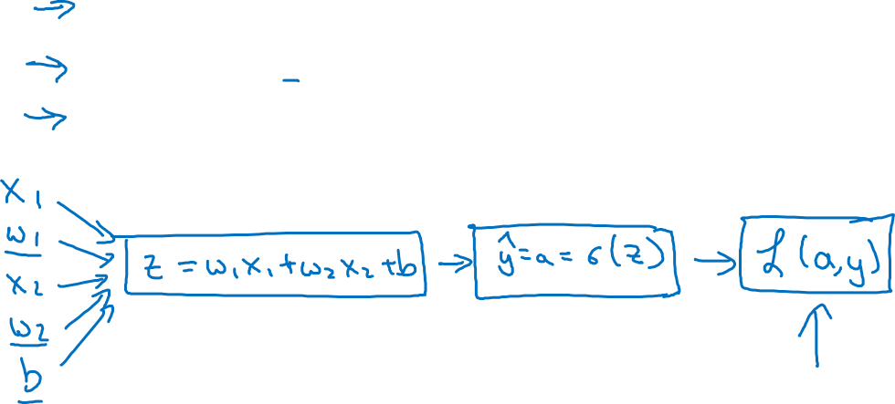

Logistic regression recap
$z=w^{T}x+b$
$\hat{y}=a=σ\left(z\right)$
$ℒ\left(a,y\right)=−$

Slide 3


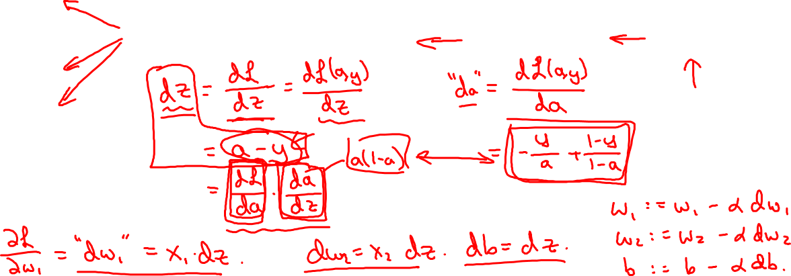





Logistic regression derivatives
$x_{1}$
$w_{1}$
$x_{2}$
$w_{2}$
b

Slide 4
Basics of Neural Network Programming
Gradient descent
on m examples
deeplearning.ai
Notes:
<number>

Slide 5
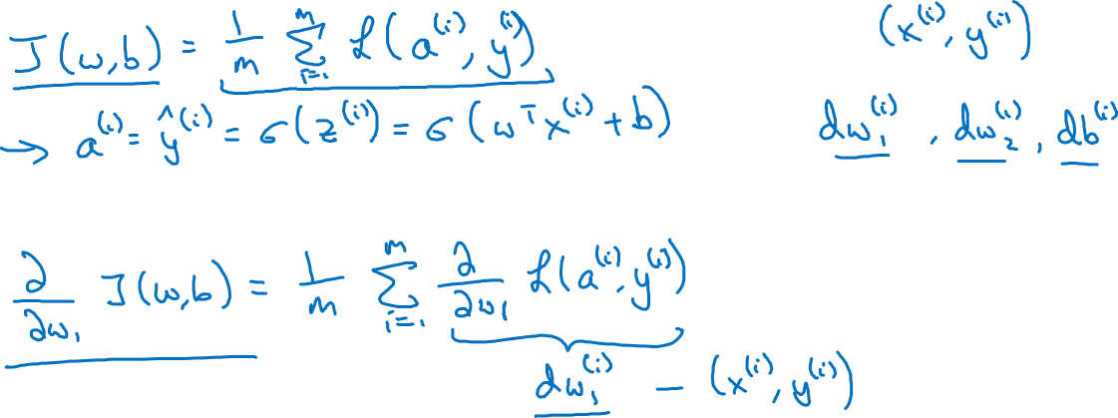
Logistic regression on m examples

Slide 6
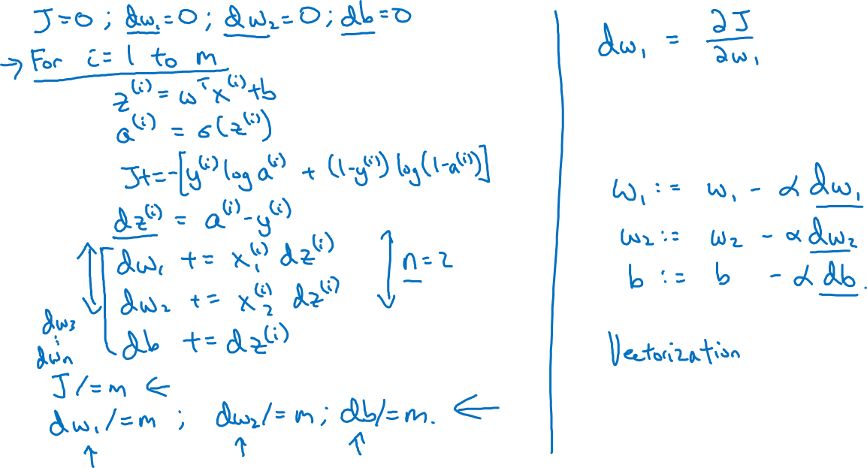
Logistic regression on m examples

